Slide 1

Chandra X-ray Observatory
Returning the HRC to Science
Discussion on HRC Thermal Status
Ralph Kraft & the HRC Operations Team
D. Patnaude, R. Kraft, P. Nulsen, G. Tremblay, T. Gauron, A. Kenter, K. Gage, B. Bissell

Slide 2
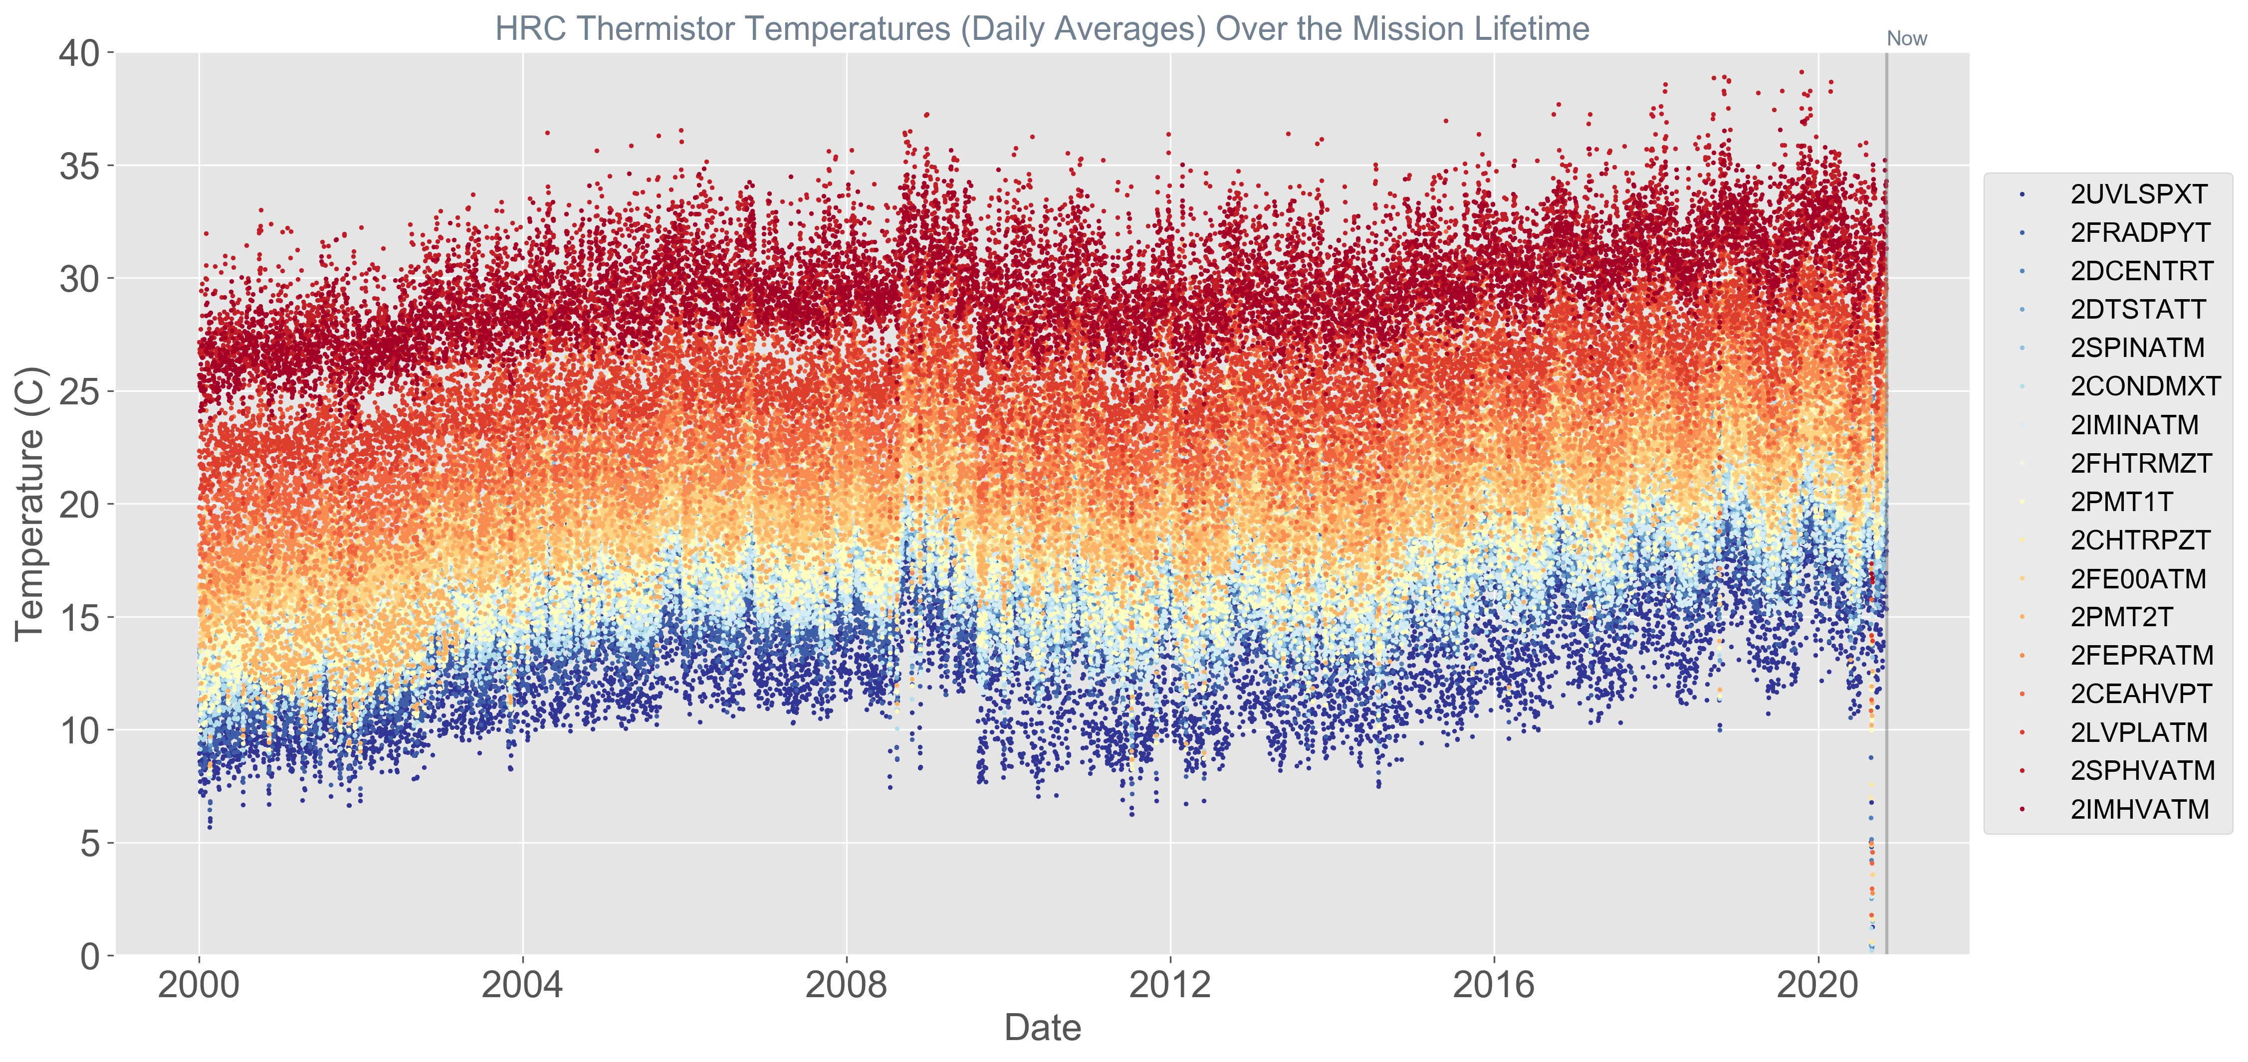

Slide 3
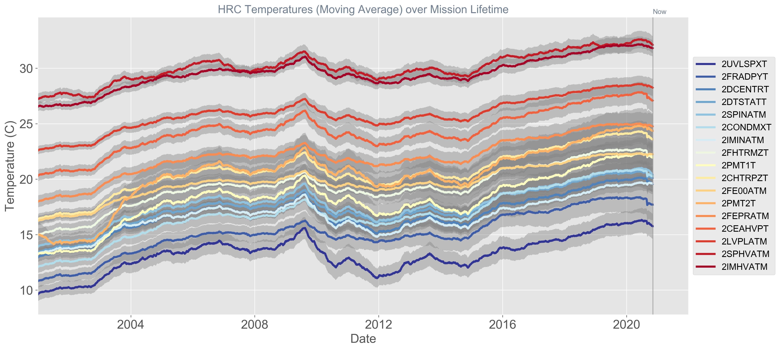

Slide 4
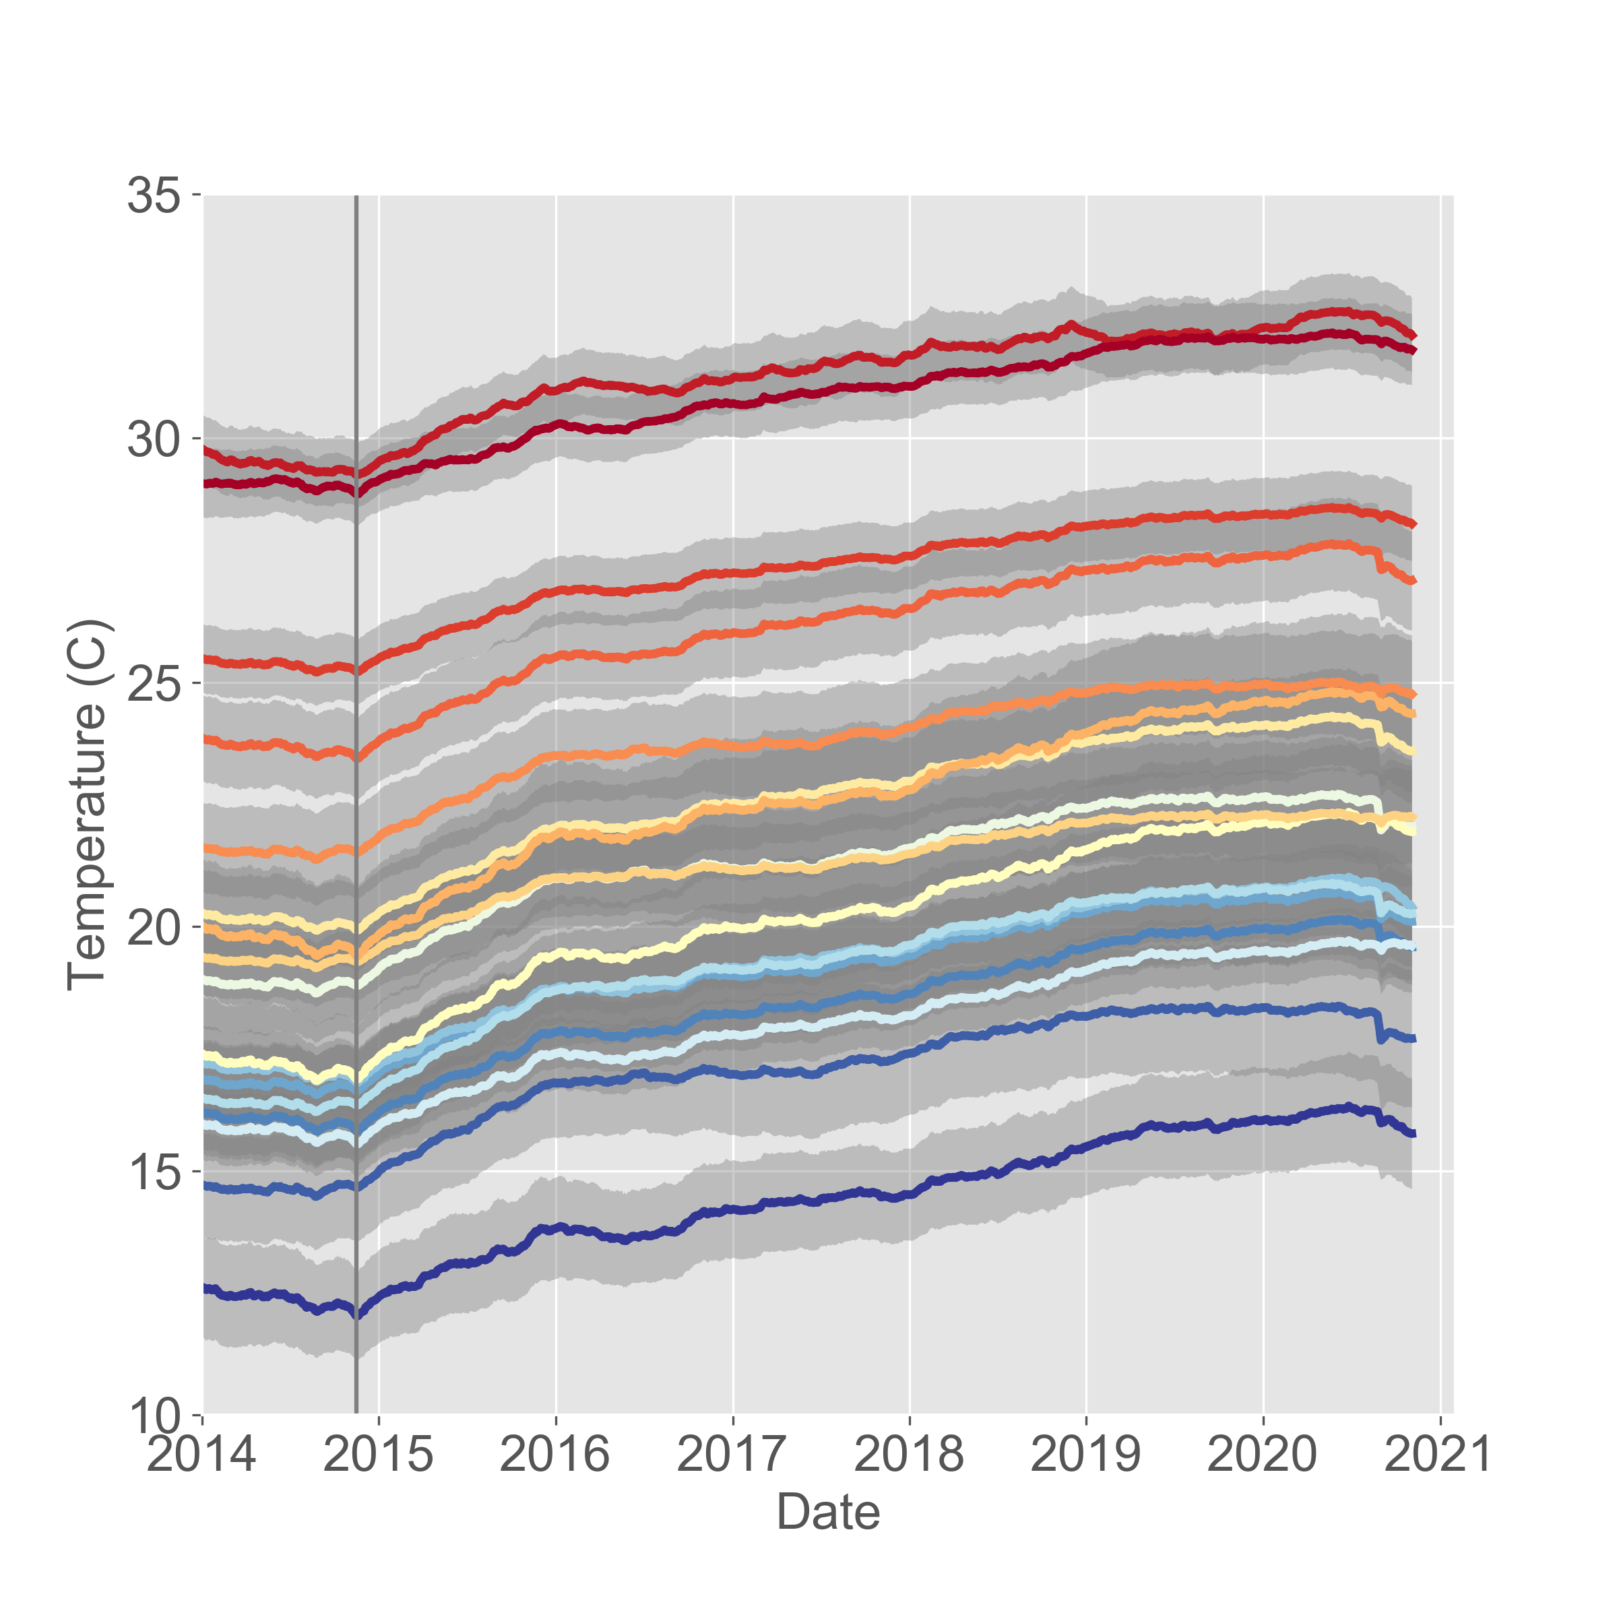
Sharp decline in moving average is largely due to the (very) cold period we sat in during the shutdown.
The anomaly recovery shutdown saw the coldest temperatures for the HRC since launch.

Slide 5
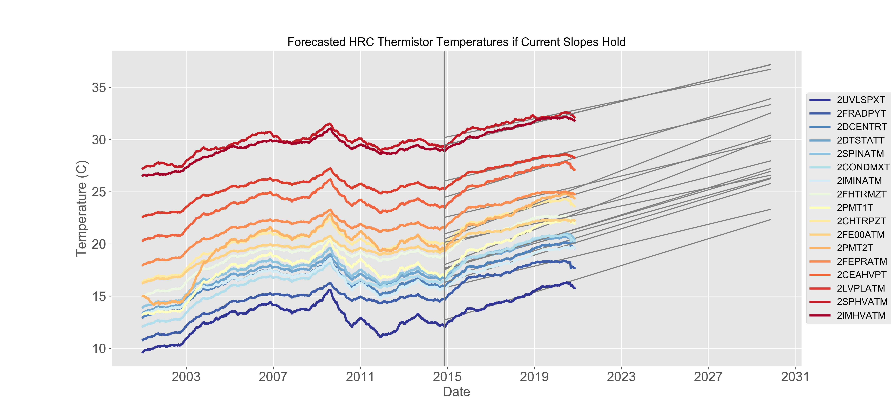
If (naively) we simply assume that the current warming trend holds,
there is plenty of headroom until we reach our CAUTION limits.

Slide 6
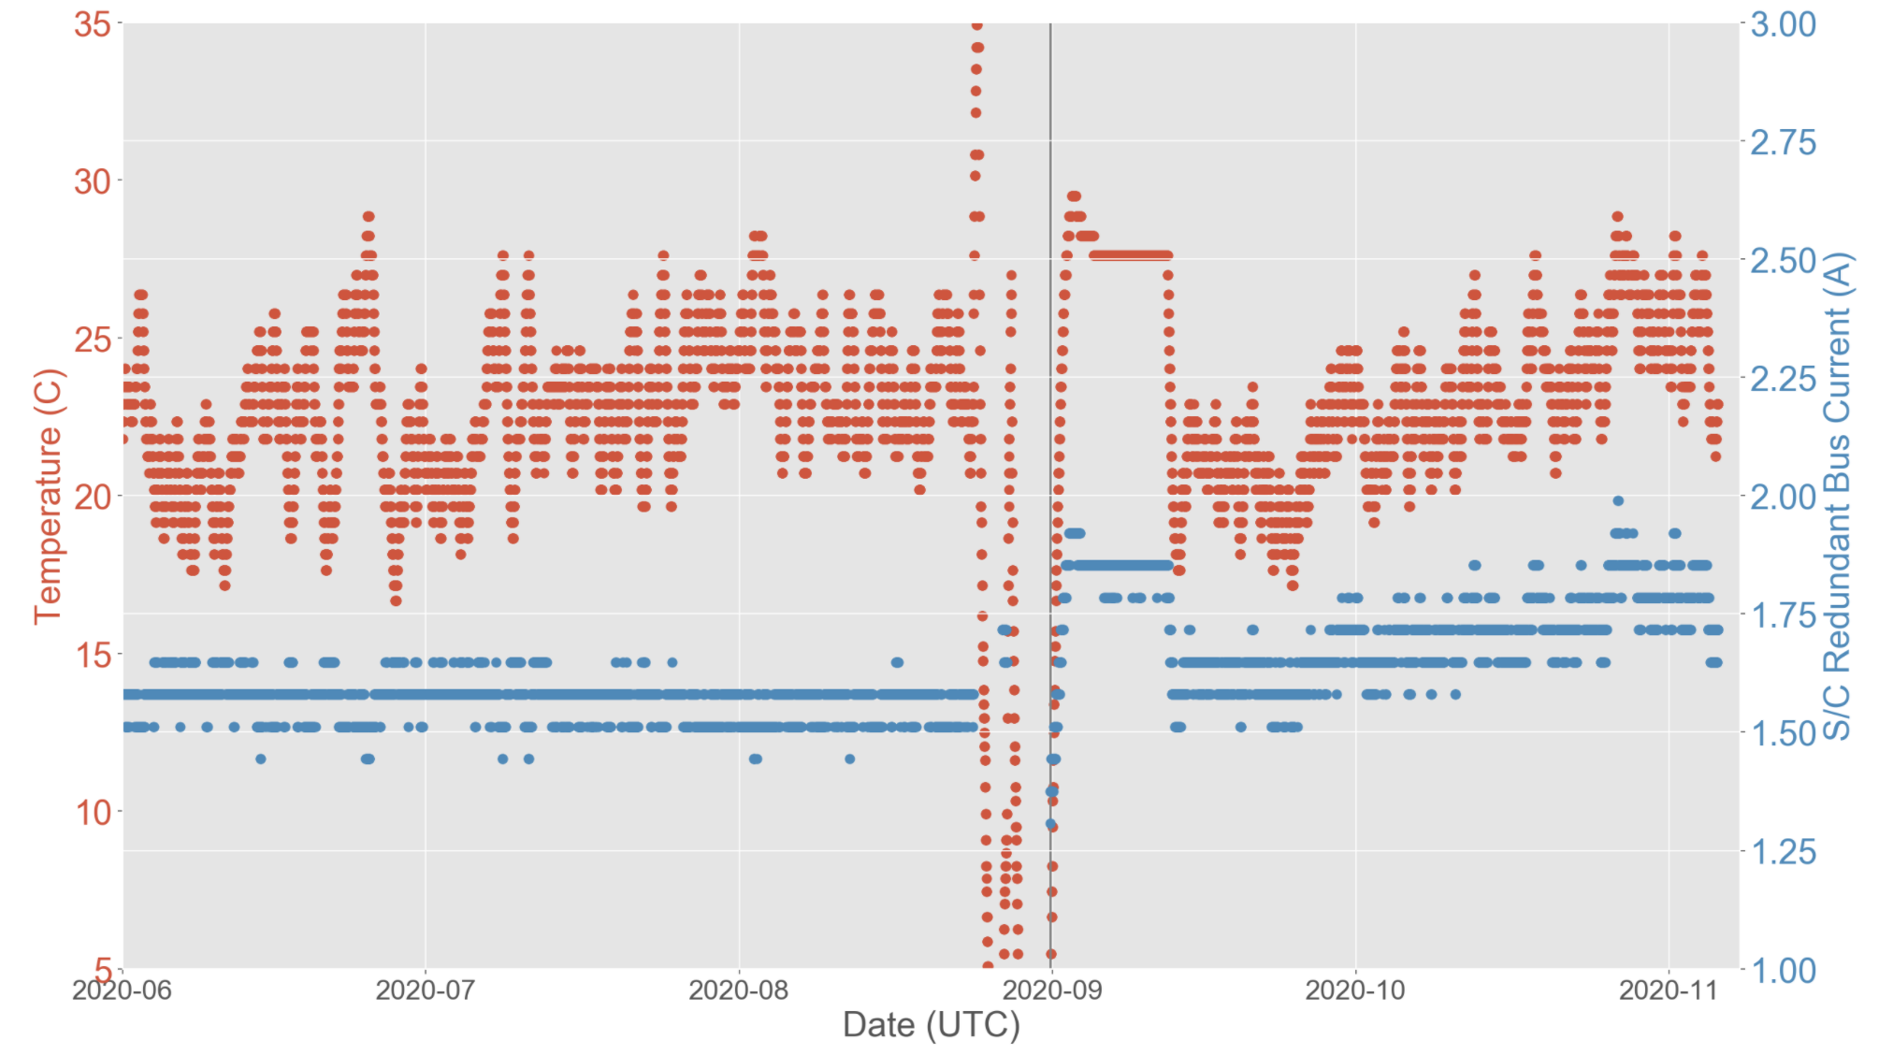
We are still investigating why the S/C Bus current is now more strongly (and positively) correlated with temperature
A-side operations
B-side operations

Slide 7
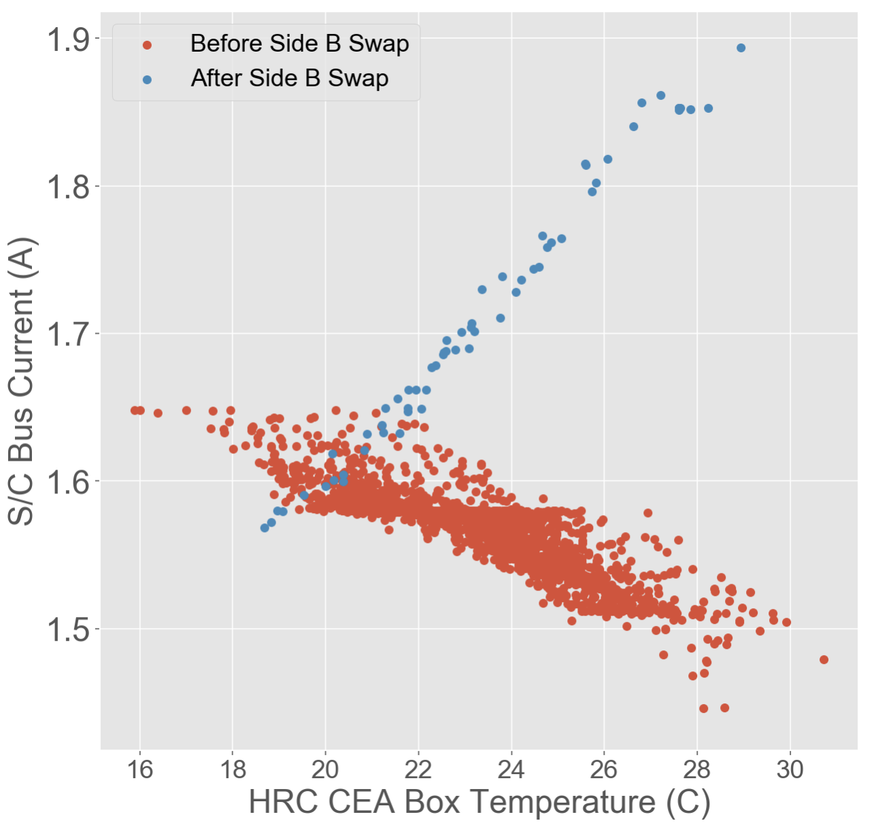
On the A side, the thermal coefficient was negative and fairly shallow. On the B side, it’s positive and steeper.
One blue point for every day since the B side swap (daily average)

Slide 8
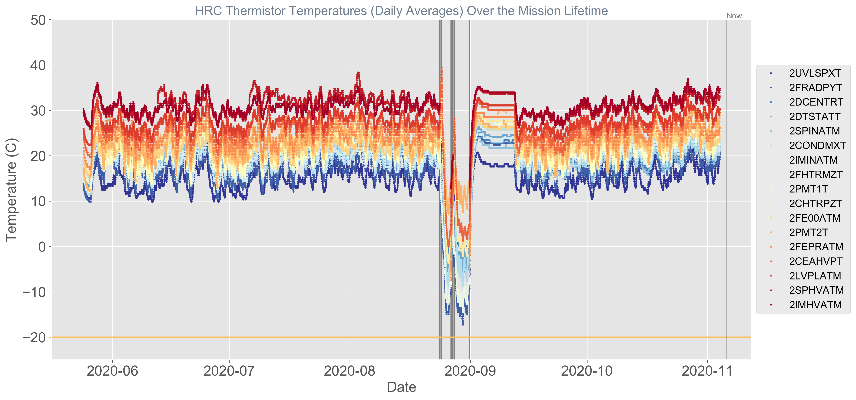
We are not systematically running any warmer on the B side than we were on the A side.
There is, therefore, little thermal evidence that we are dissipating (much) more power.
A-side operations
B-side operations
Common MSID CAUTION limit

Slide 9
EXTRA SLIDES

Slide 10
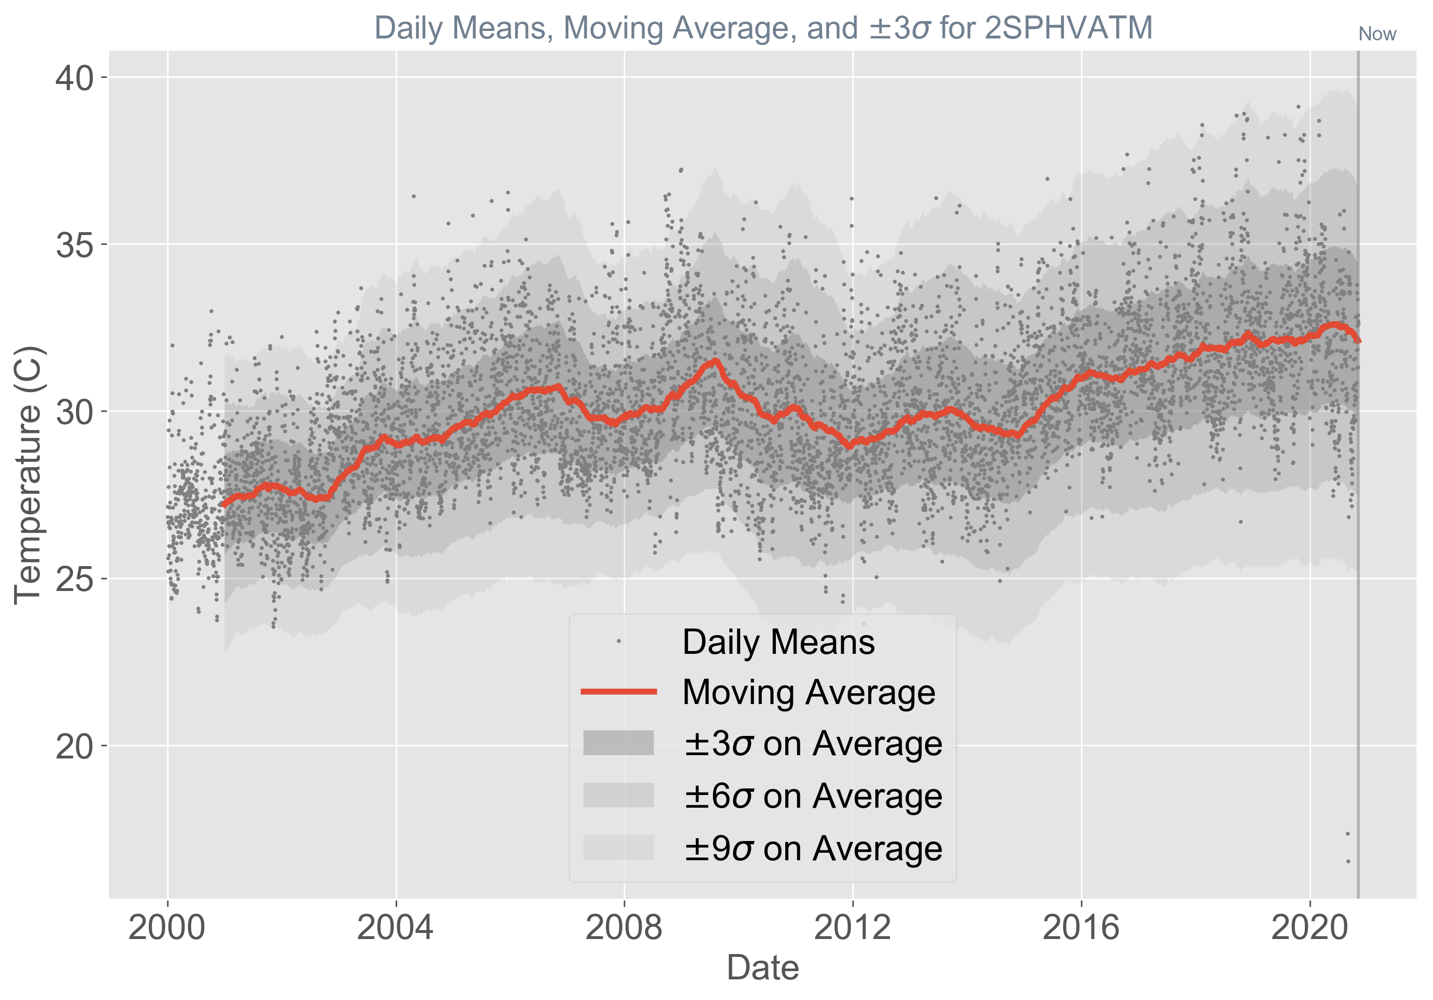

Slide 11
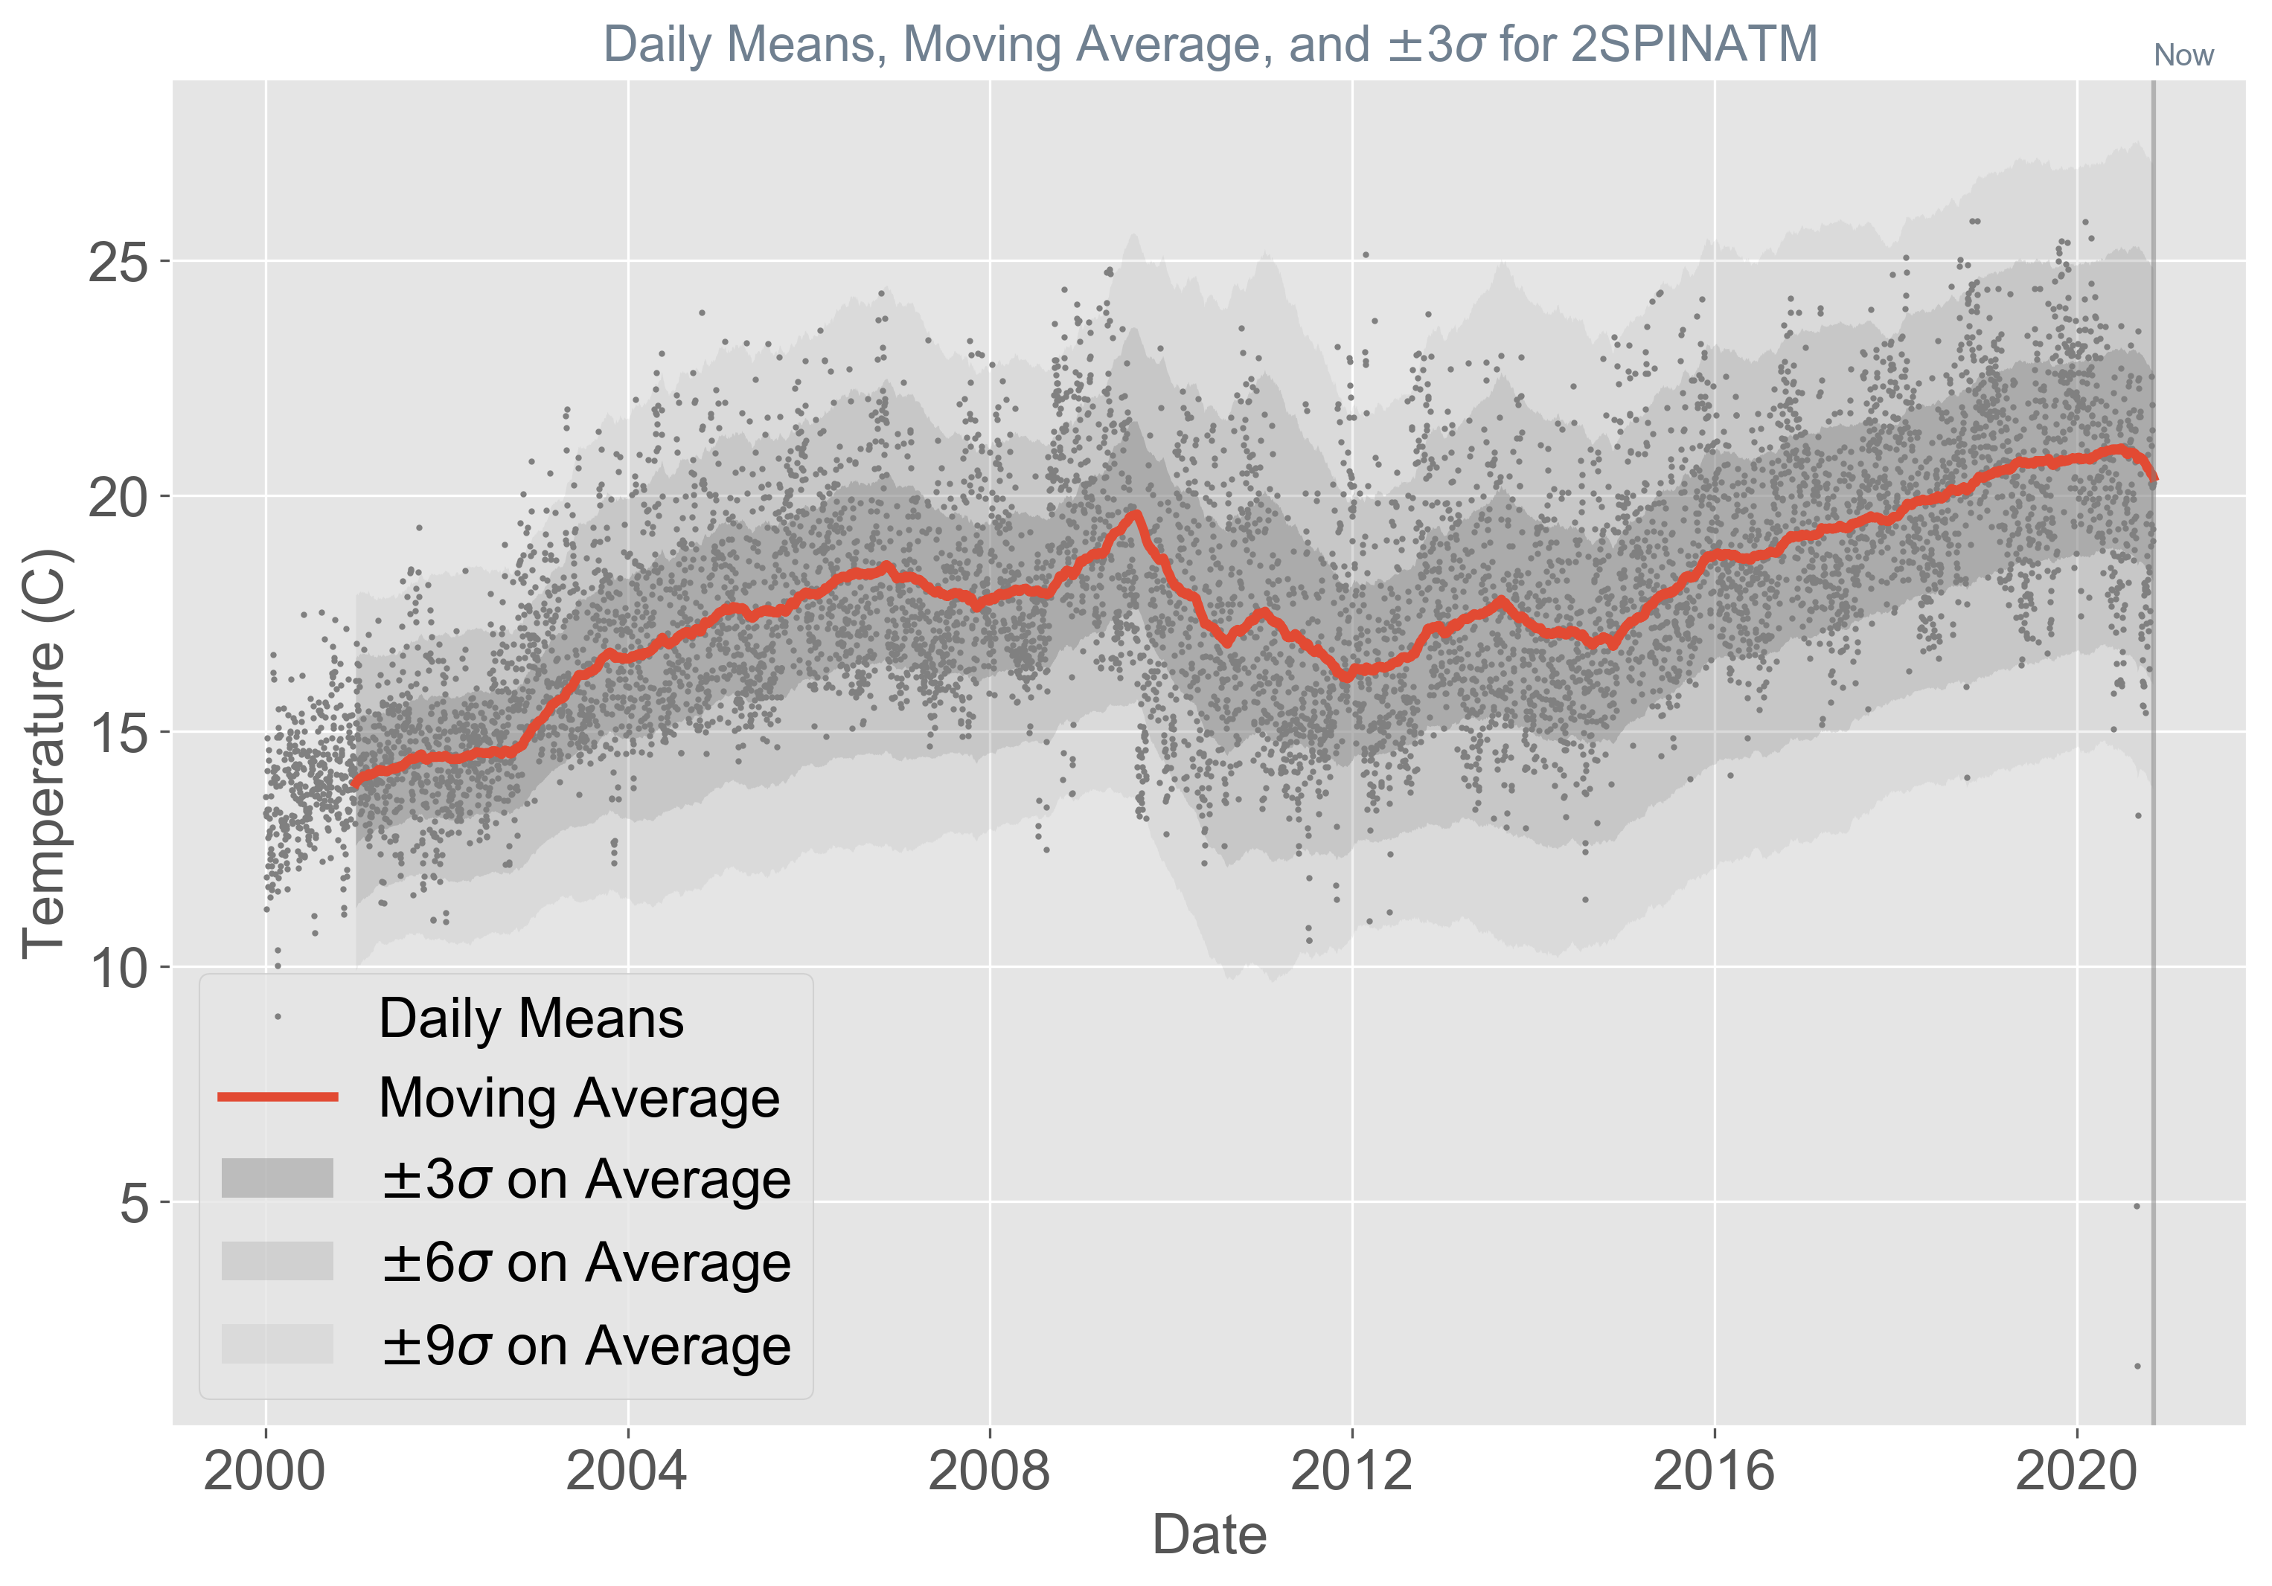

Slide 12
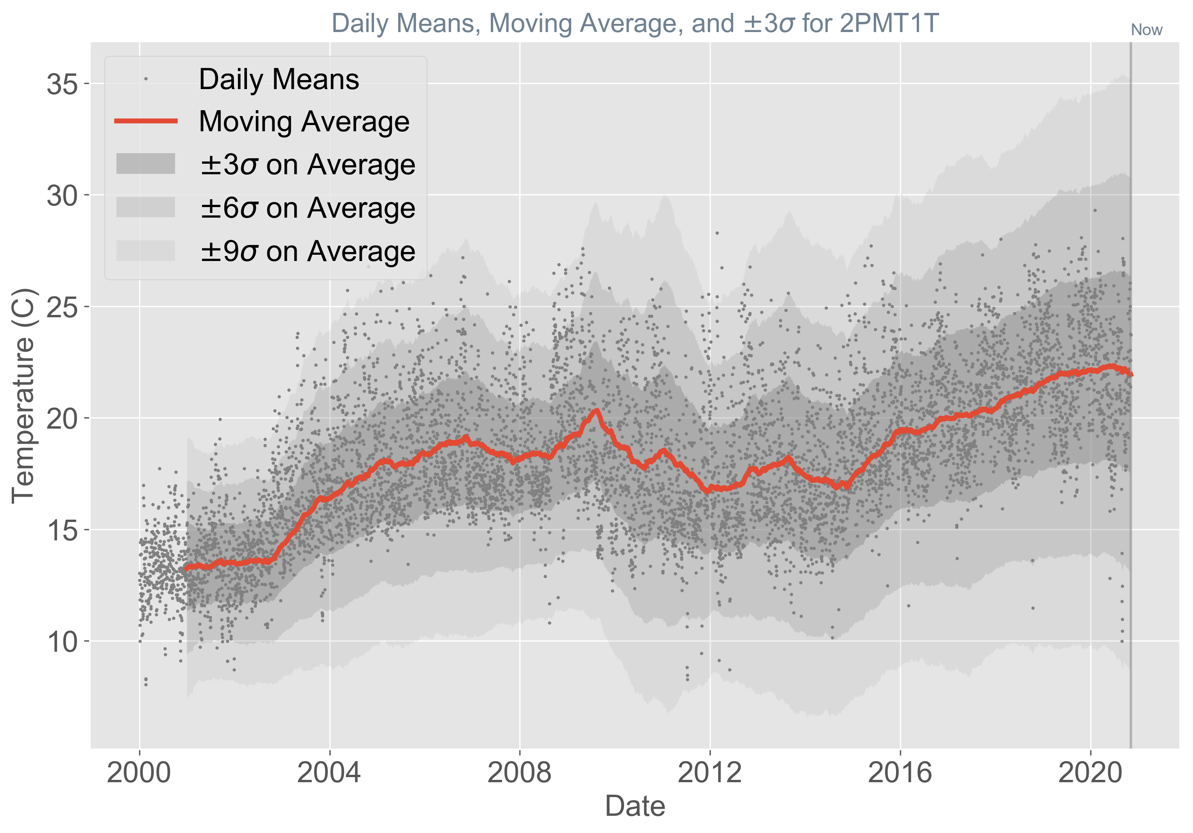

Slide 13
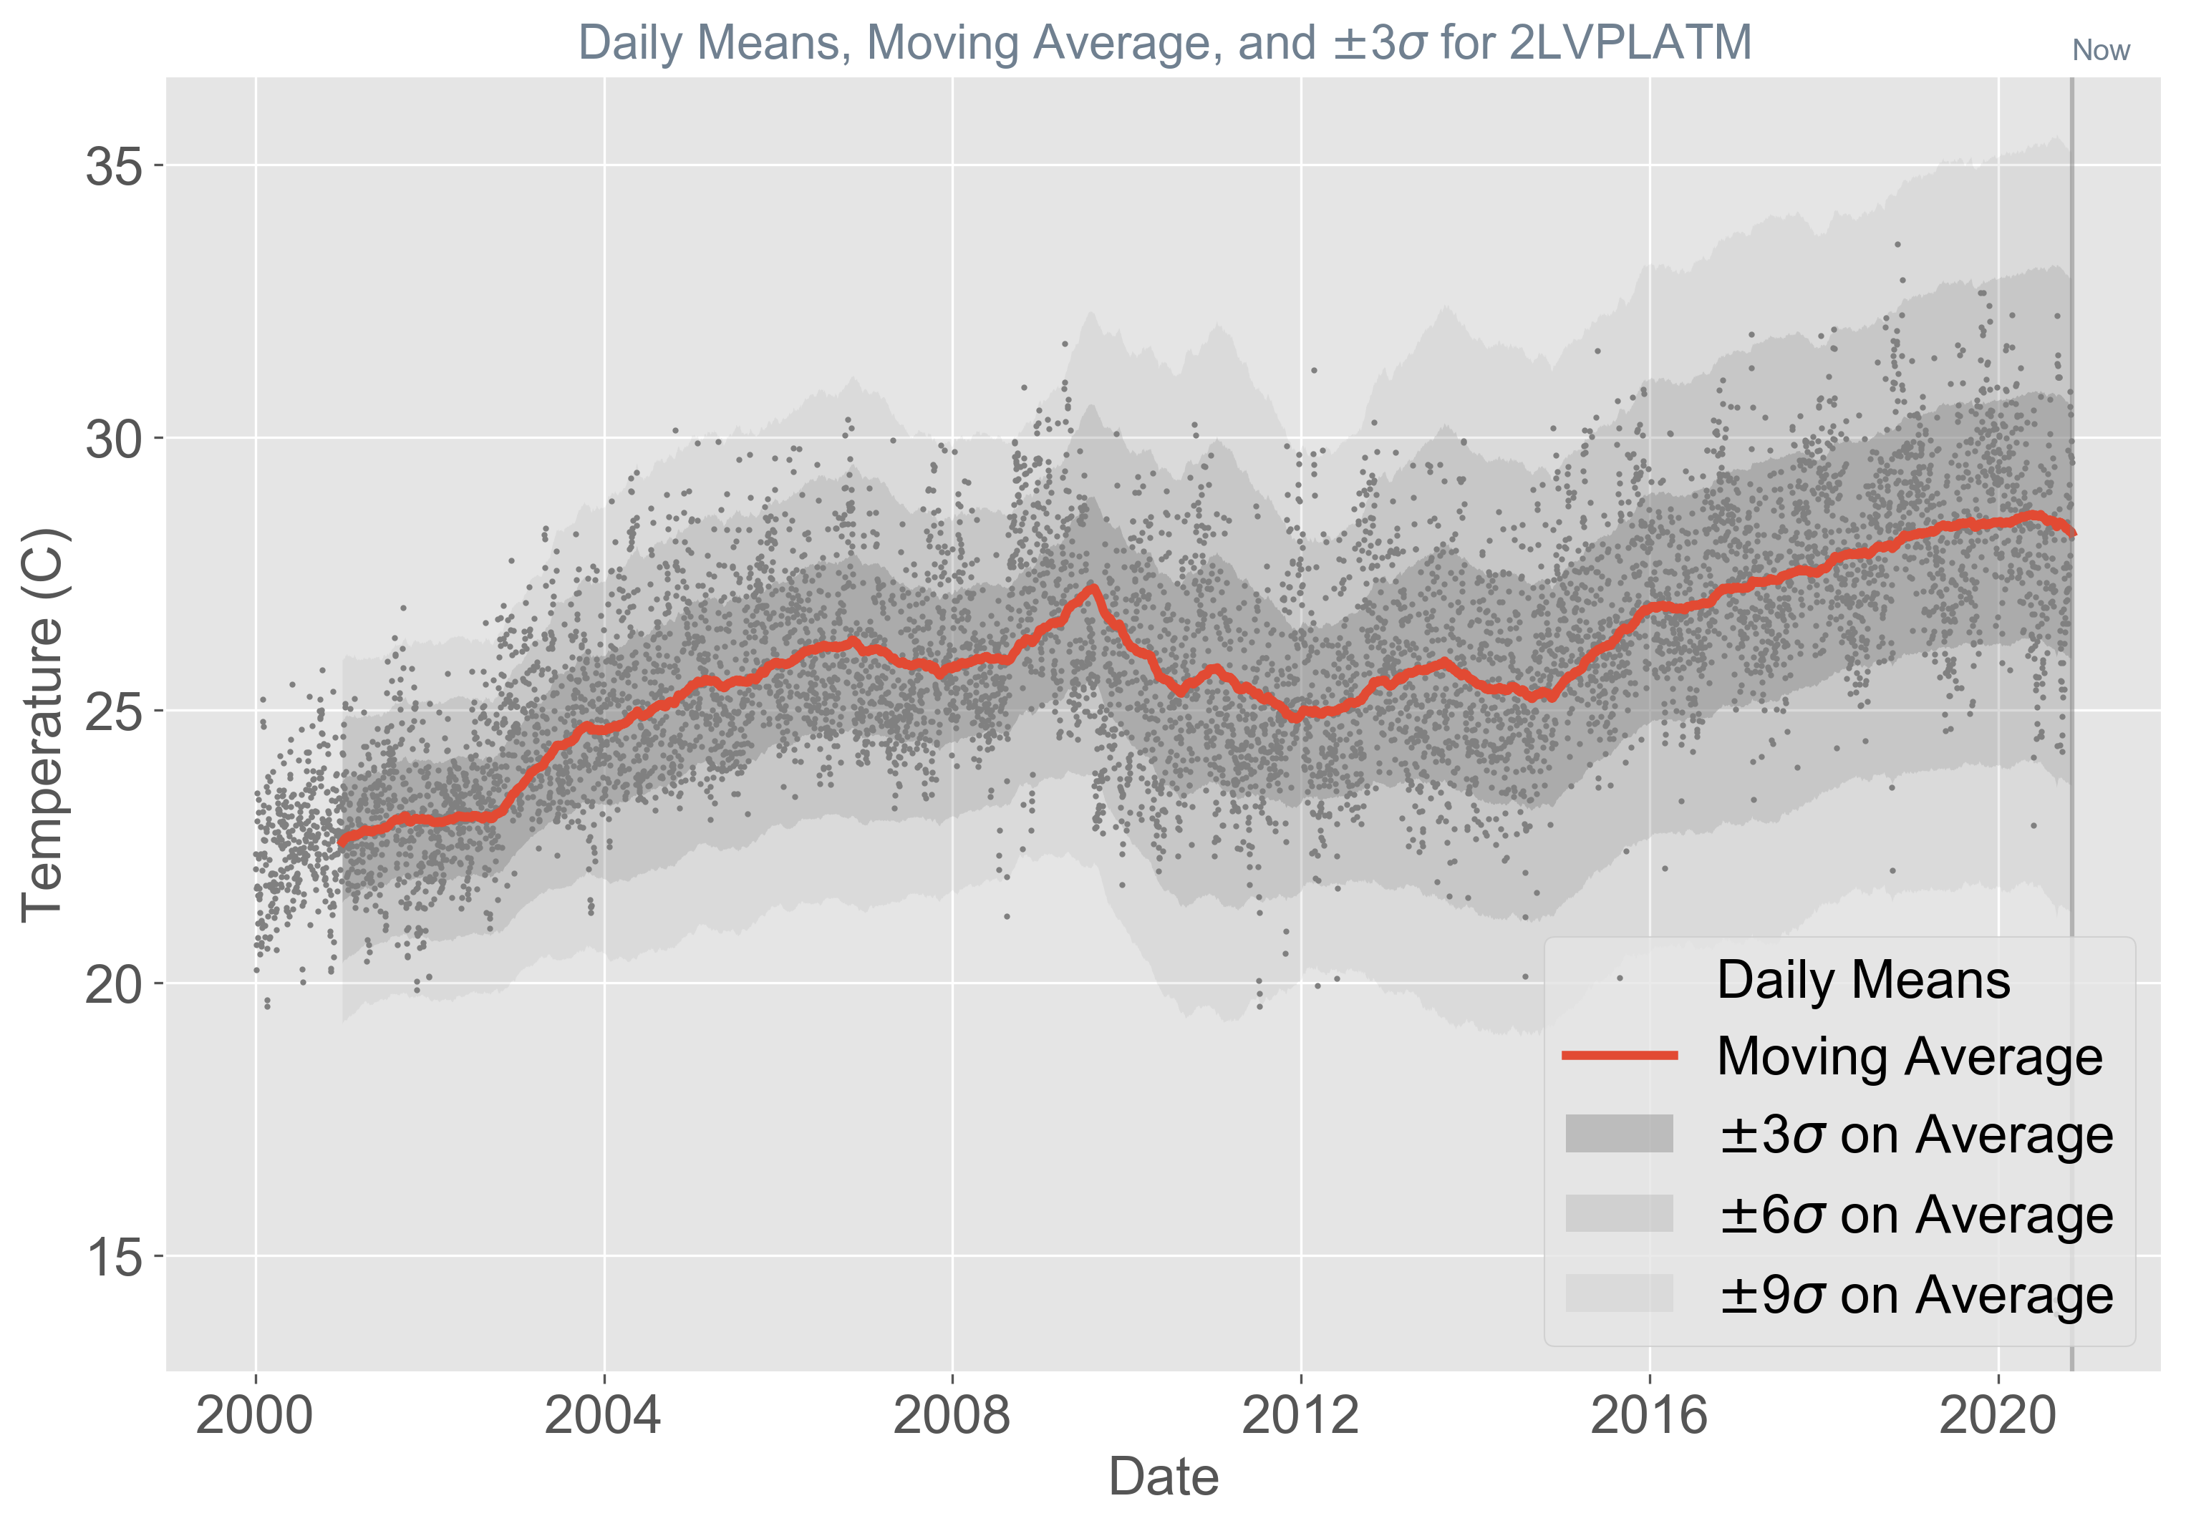

Slide 15
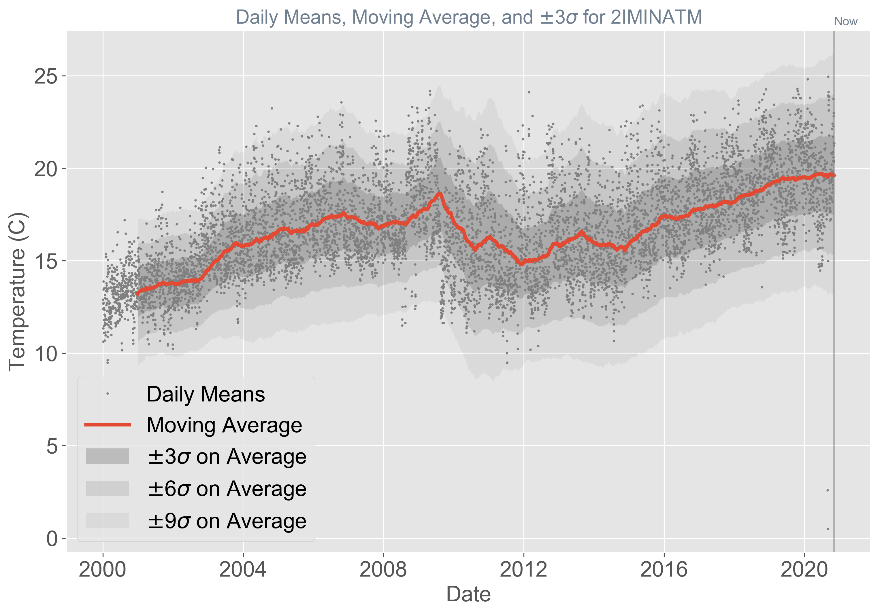

Slide 16


Slide 17
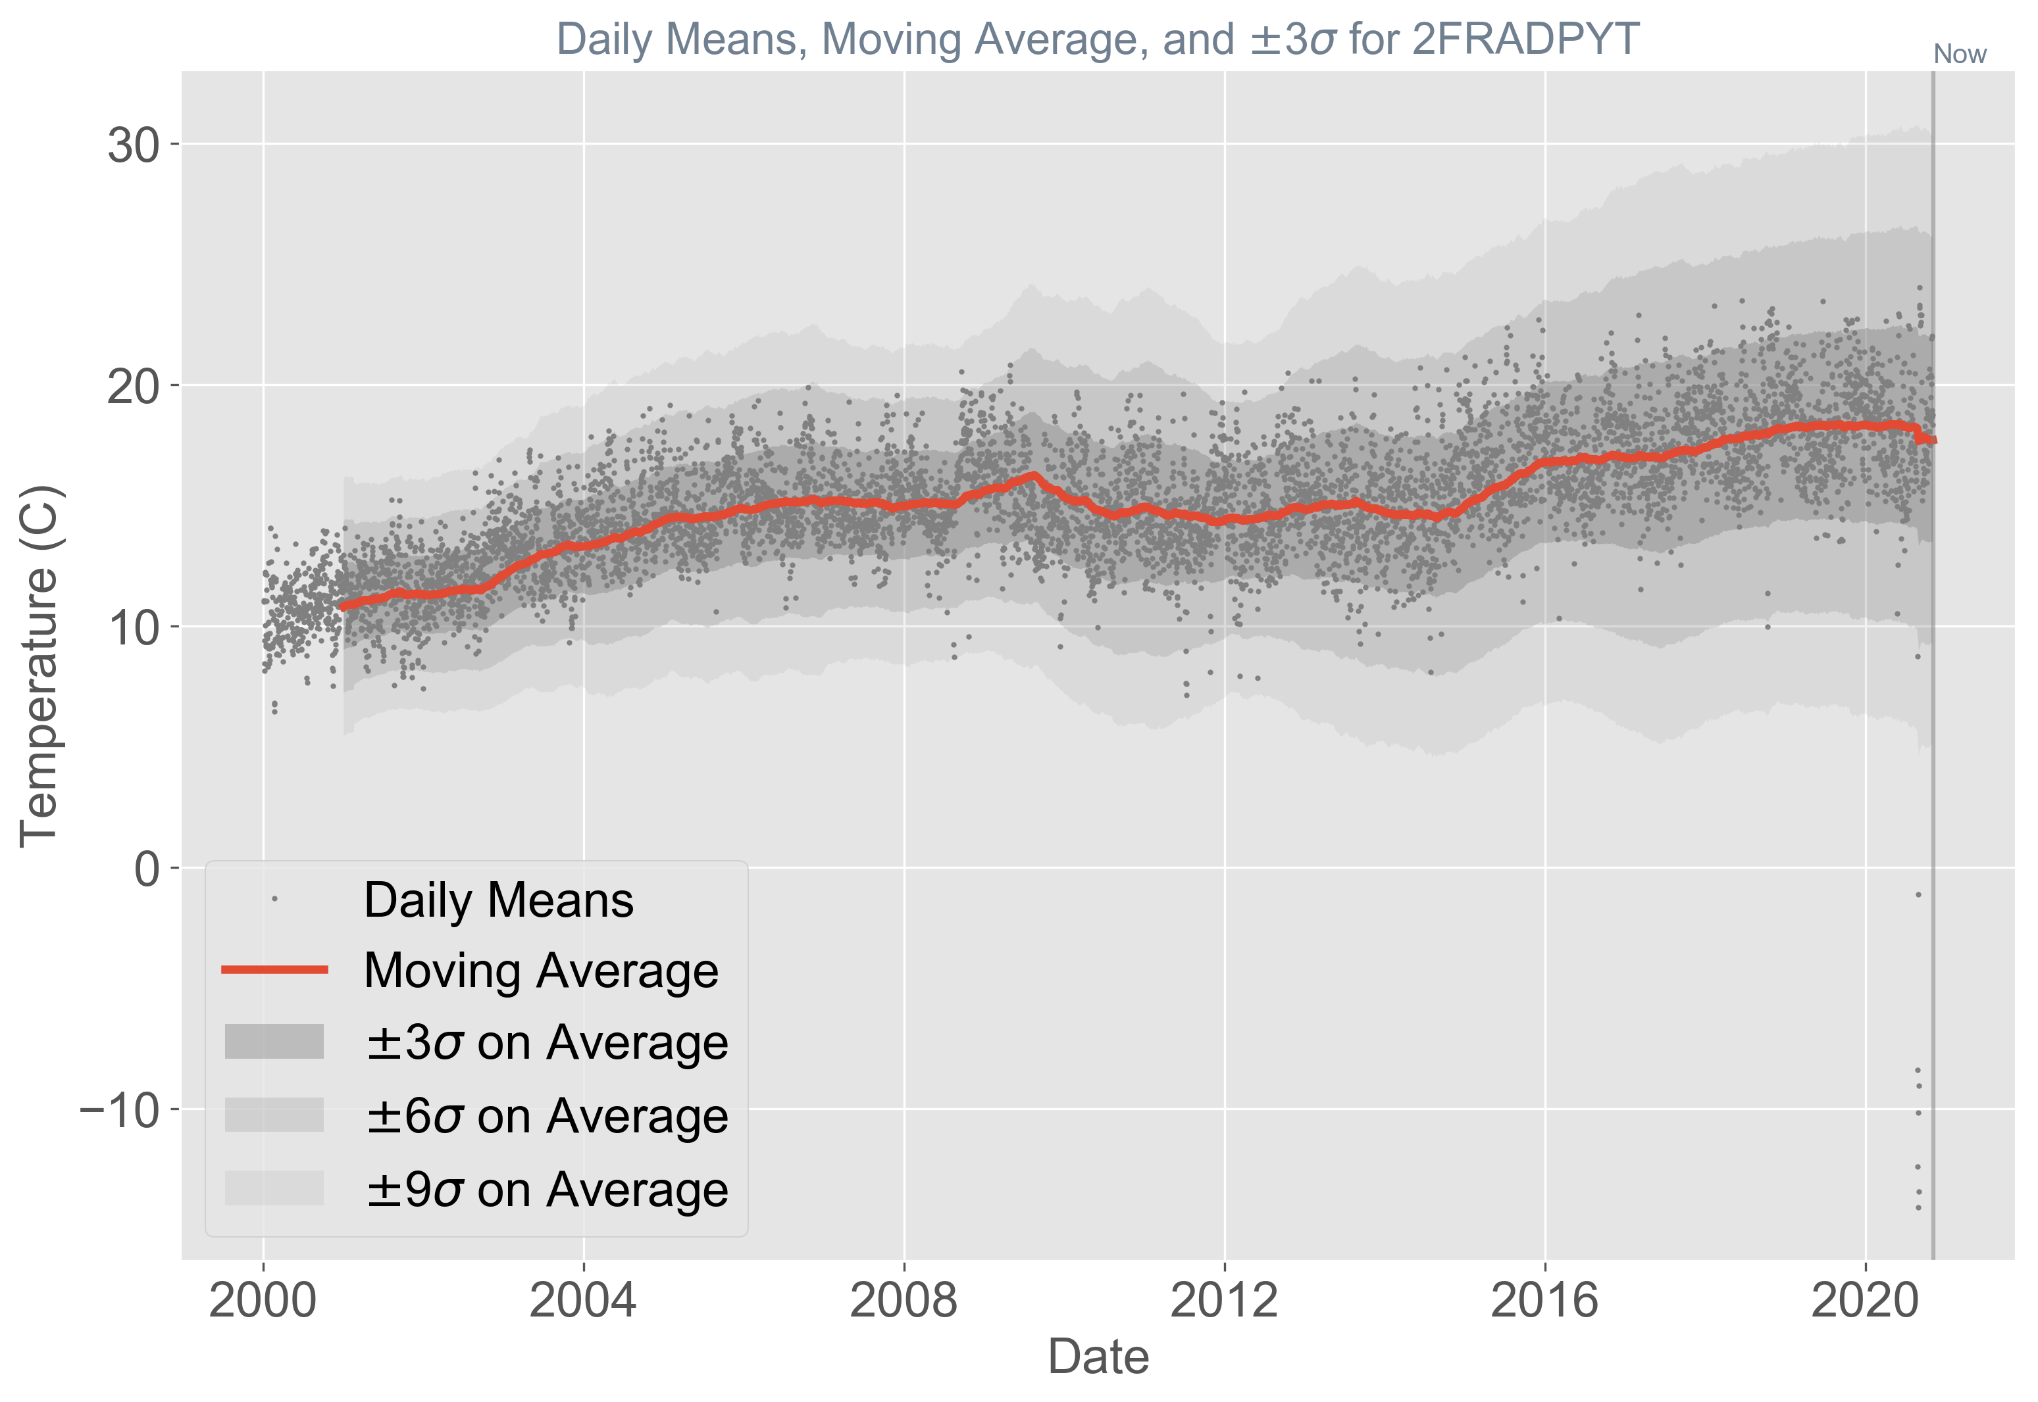

Slide 18
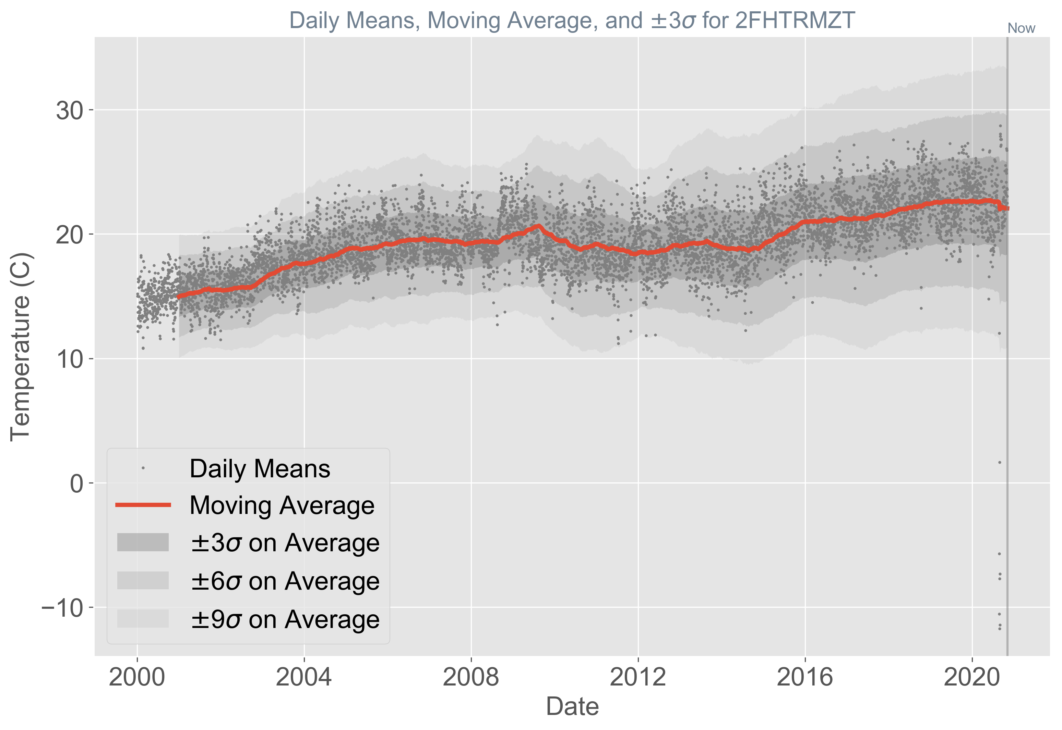

Slide 19
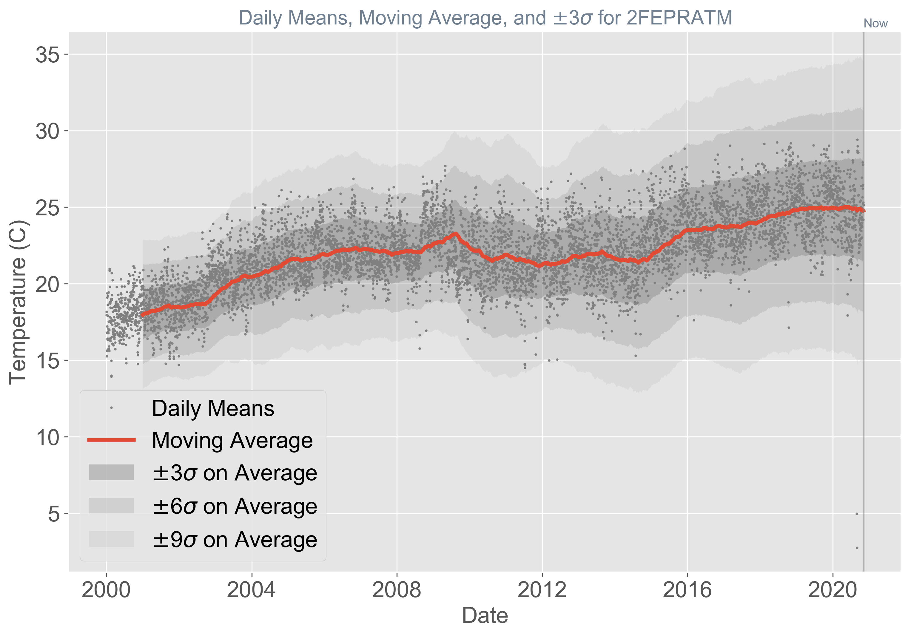

Slide 20


Slide 21
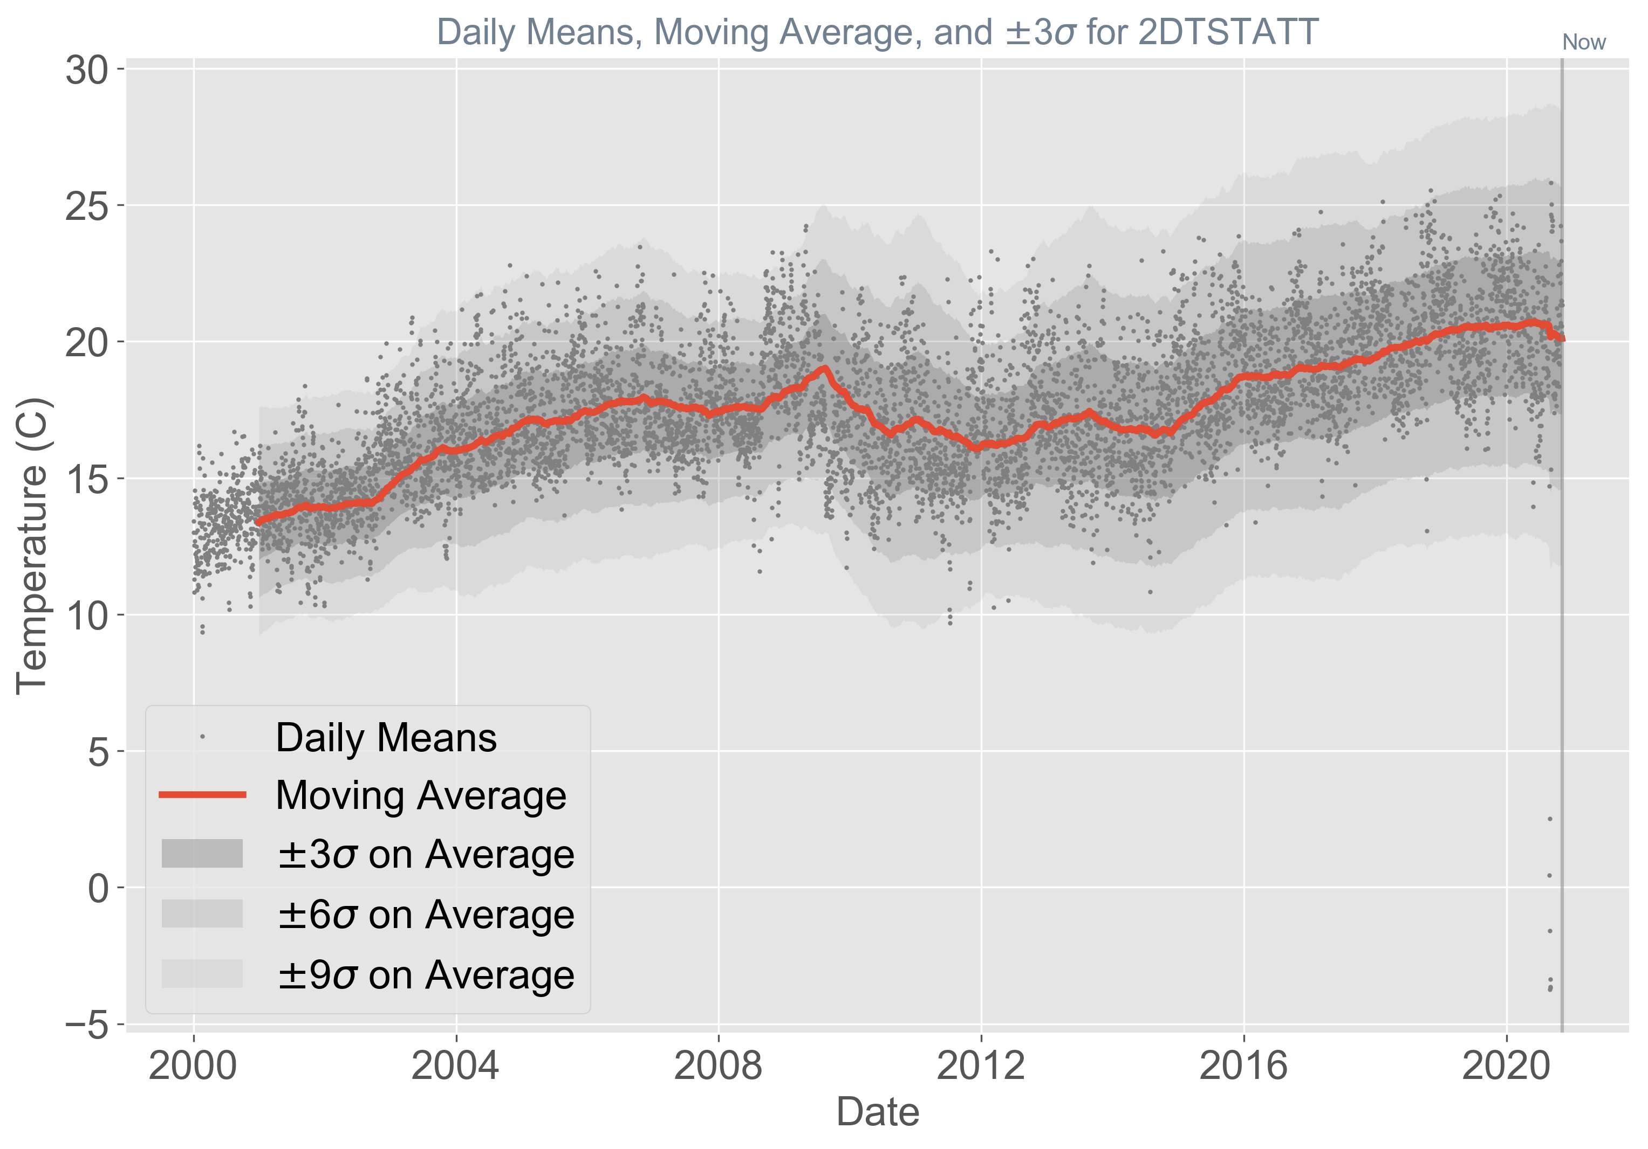

Slide 22


Slide 23
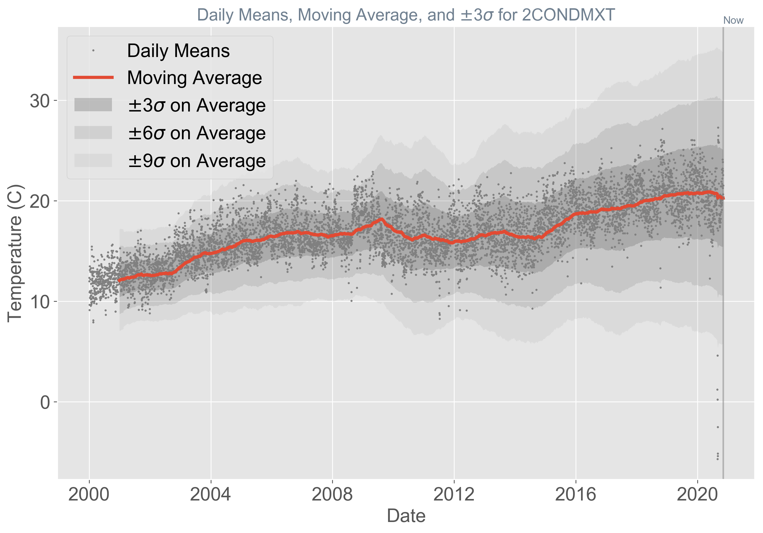

Slide 24
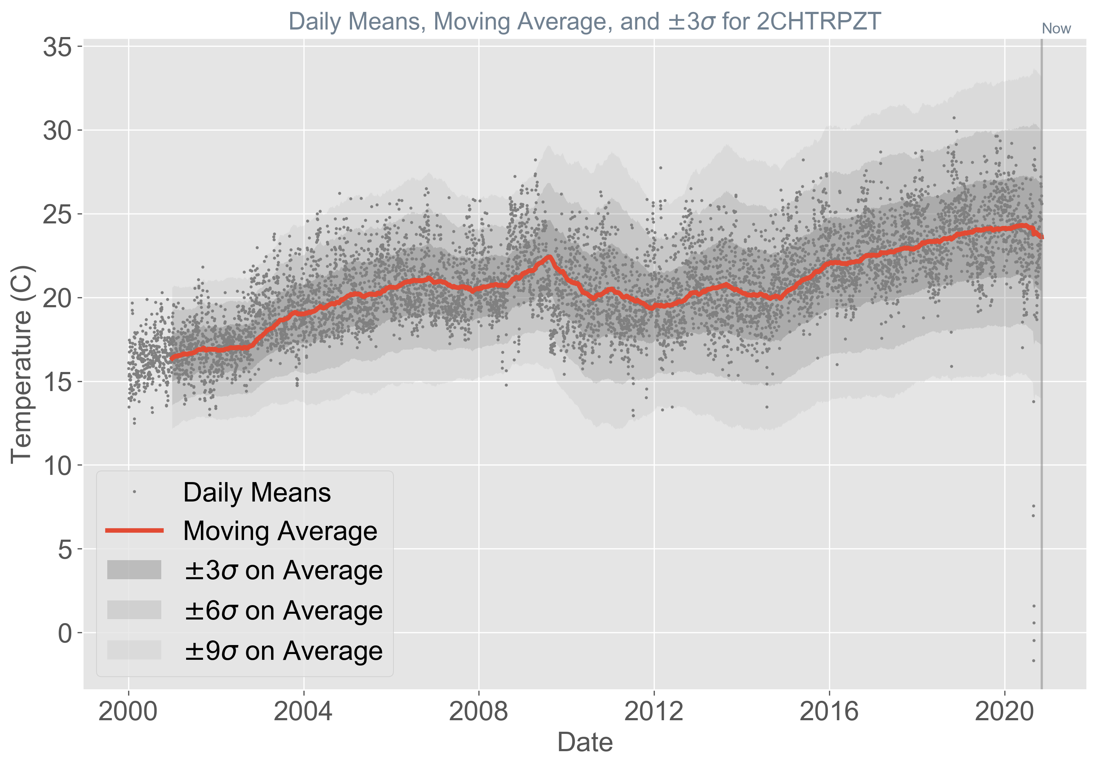

Slide 25
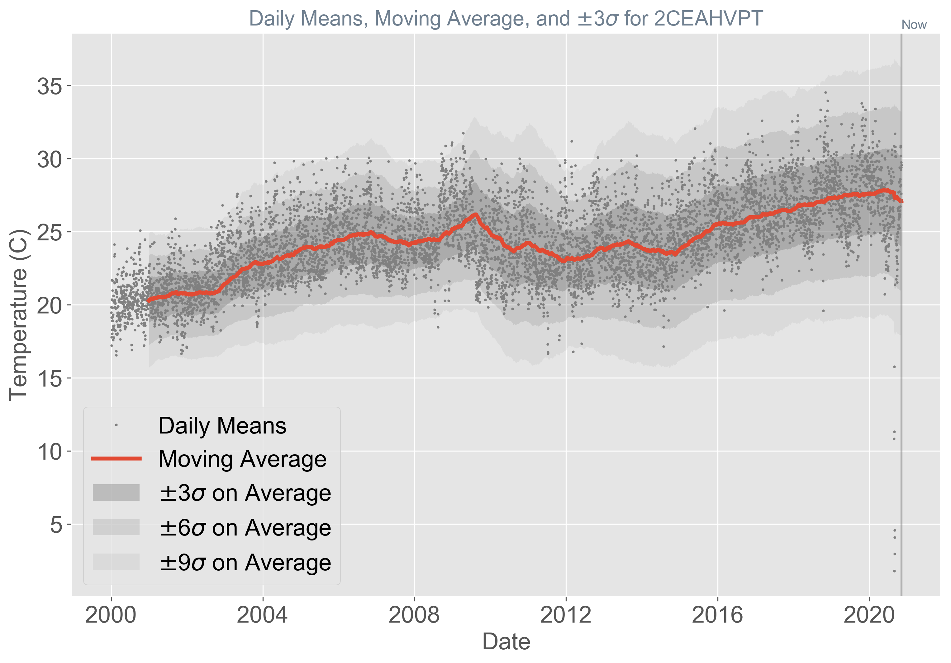

Slide 26
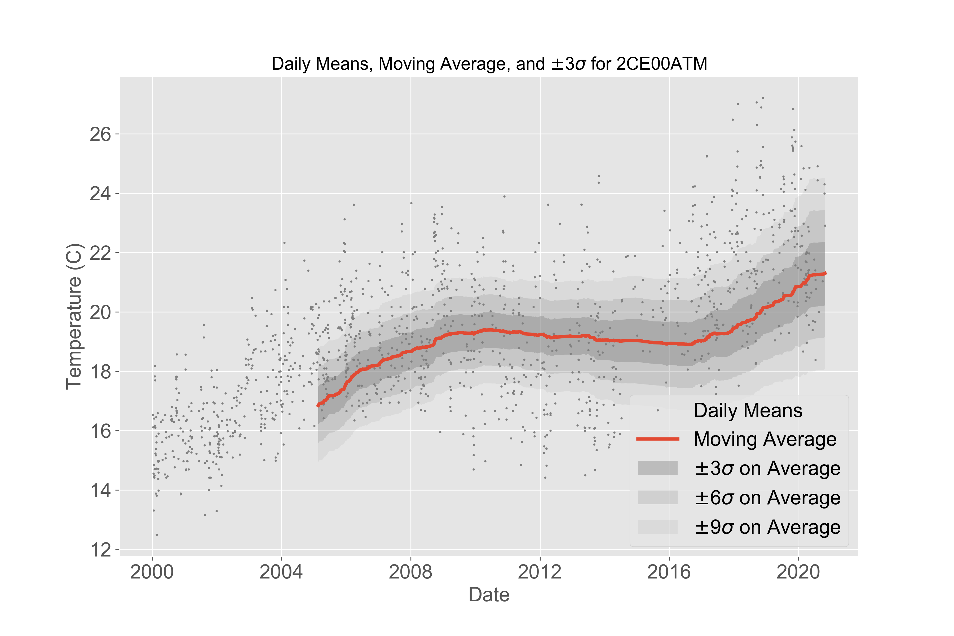
THIS MSID HAS FAR LOWER DATA DENSITY IN SKA

Slide 27
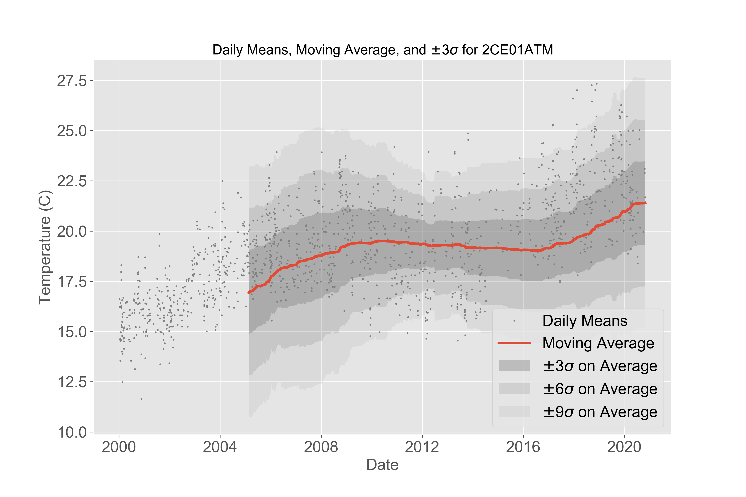
THIS MSID HAS FAR LOWER DATA DENSITY IN SKA

